Slide 1
Ohio Credit Flexibility Community of Practice Launch
Ohio Department of Education
Great Lakes East Comprehensive Center
IDEA Partnership
January 24, 2012
1:30–2:30 p.m.

Slide 2
Purpose of Today
Share information about the Credit Flex Community of Practice (an online tool)
Discuss the intended use of CoP to support local implementation of the credit flexibility policy
Engage participants in the field test of CoP
Notes:
Patti

Slide 3
Who Is On the Line?
Quick Polling
Are you already familiar with the community of practice strategy?
Are you currently participating in a community of practice?
What best describes your primary role?

Slide 4
Our Objectives
Introduce participants to the Ohio Credit Flex Community of Practice (CoP) and its intended use
Provide an overview of the CoP site and a quick walk-through of its features and functions
Increase understanding about a community of practice (what it is/is not)

Slide 5
Our Objectives
Share community building and engagement strategies
Respond to questions and concerns about the credit flex CoP
Foster thinking and conversations at a local level
Notes:
Intended Outcomes:
Join the CoP for dialogue and discussion
Field test CoP site with soft audience to get feedback before statewide launch of CoP site
Understand CoP as a strategy of communication

Slide 6
Definition of CoP
“Communities of practice are groups of people who share a concern, a set of problems, or a passion about a topic, and who deepen their knowledge and expertise in this area by interacting on an ongoing basis.”
(Wenger, McDermott, & Snyder, 2002, p. 4)

Slide 7
What Is/Is Not CoP?
CoP Is:
A dynamic organization that utilizes tools
Reflective of distributive and shared leadership and decision making
CoP Is Not:
A platform (Wiki) or tool (discussion board)
Tied to a traditional hierarchy or organizational structure

Slide 8
Advantages
Improved communication and dissemination avenues
Engaged partners to help examine complex issues
Increased likelihood of sustainability
More effective feedback loops
Enhanced coherence across implementation levels
(Cashman, Linehan, & Rosser, 2007, p. 4)

Slide 9
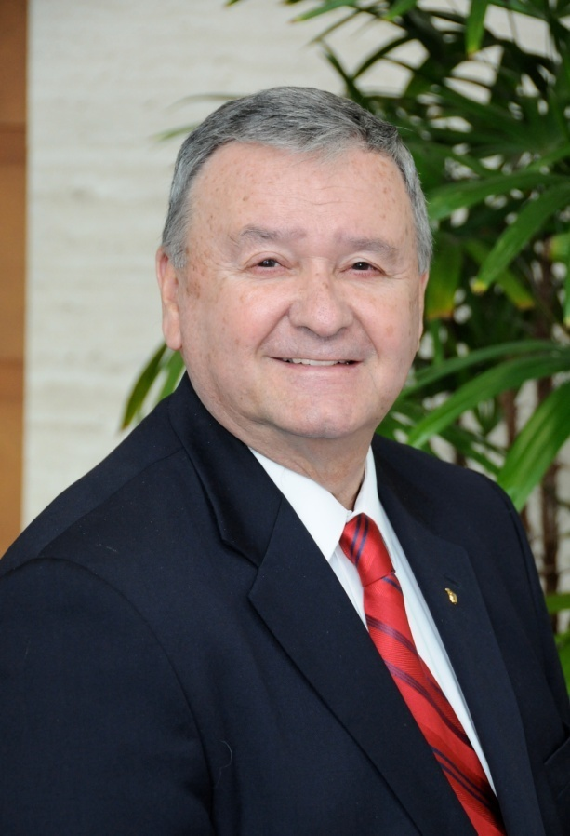
Tom Rutan
Associate Director
Curriculum and Instruction
Phone: (614) 728-1997
E-mail: tom.rutan@ode.state.oh.us
Ohio Department of Education
25 South Front Street
Columbus, OH 43215
education.ohio.gov
Notes:
Why did ODE choose the CoP as an approach to providing implementation support?
What’s in it for users?
What can they expect?
What are the expectations for the credit flex COP?

Slide 10
SharedWork.org Ohio Credit Flex
Notes:
Click on Tom’s video to demo.

Slide 11
Ohio Credit Flex CoP Site
Demo of the site http://sharedwork.org:8650/web/guest
Site Features (e.g., wiki)
Major Functions for Users (e.g., ask a question)
Overall Process (e.g., contact a content expert)

Slide 12
IDEA Partnership CoP Model
Developed specifically for state education agencies
Designed to engage stakeholders in authentic collaboration and concrete work
Utilizes technology to connect participants statewide

Slide 13
The IDEA Partnership Approach to Community Building
CoPs : The IDEA Partnership Way
New kinds of leadership
Translate complex challenges into ways that individuals can
contribute
Shared Concerns
What will bring people together?
Leading by convening
Coalescing
around issues
Doing work together
Ensuring relevant participation
Focus on the work and the relationship
Recognize Individual pursuits and shared goals
The right mix of stakeholders
Who must be involved to ensure changes in practice?
Infrastructure for
the CoP

Slide 14
How Can Interaction Build Understanding in a CoP ?
Formal Interaction:
Traditional Ways of Learning
Informal Interaction:
Social Ways of Learning
Trainings
Webinars
Guidance and other documents
Information shared with districts
Information shared at meetings
Etc.
Calendar announces events widely.
Webinars have follow-up on a wiki for comment and follow-up in using the content.
Polls on key issues to check for understanding and clarification needed.
Blogs articulate perspectives raised in the Poll.
Documents are shared from DOE and other sources
Districts are invited to share
Organizations and groups are invited to share
And much more....

Slide 15
Four Quadrants: Learning From and With Each Other
Informal Learning
From
With
Formal Learning

Slide 16
Four Quadrants: Learning From and With Each Other: Sample
Informal Learning
5. Blogs share comments ideas from important perspectives
4. Polls check for understanding on key content
3. Wiki started to permit interaction on document and the webinar
6. DOE points to important learning from interaction on the issue
From
With
1. DOE releases document
2. DOE hold webinar to discuss document
Formal Learning

Slide 17
Examples for Building Interaction
Take key points from this webinar and share them on the poll/blog
Attended a PD event at your district? Use the CoP site to invite a district response.
Create a guidance document draft on third-party providers
Explore a common issue/challenge with a team of peers
Submitted a question prior to this Web event? Find answers on the site!

Slide 18
Got Questions?
Submit a question or comment through the Chat Pod.
To verbally ask a question, click on this icon and select “Raise Hand” to let us know you have a question.

Slide 19
Engage!
What am I supposed to do?
How am I supposed to do it?
When do I visit the site?
What’s in the CoP for me, again?

Slide 20
Next Steps
Register!
SharedWork guides for users will be posted on the CoP site.
Answers to your questions submitted through the Chat Pod will be posted on the Message Board on the CoP site.
Archive materials of today’s event will be posted on the CoP site and the ODE website.

Slide 21
Need Help?
Contact Great Lakes East for help registering and/or accessing the site
Jennifer Reed: jreed@air.org
Tori Cirks: vcirks@air.org
Asta Svedkauskaite: asvedkauskaite@air.org

Slide 22
GLE Contact Information
Tori Cirks
Technical Assistance Consultant
Great Lakes East Comprehensive Center
E-mail: vcirks@air.org
Asta Svedkauskaite
Technical Assistance Consultant
Great Lakes East Comprehensive Center
E-mail: asvedkauskaite@air.org
Notes:
Why did ODE choose the CoP as an approach to providing implementation support?
What’s in it for users?
What can they expect?
What are the expectations for the credit flex COP?

Slide 23
IDEA Contact Information
Joanne Cashman
Executive Director
IDEA Partnership
E-mail: joanne.cashman@nasdse.org
Patrice Linehan
Project Associate
IDEA Partnership
E-mail: patrice.linehan@nasdse.org
Notes:
Why did ODE choose the CoP as an approach to providing implementation support?
What’s in it for users?
What can they expect?
What are the expectations for the credit flex COP?

Slide 24
References
Cashman, J., Linehan, P., & Rosser, M. (2007). Communities of practice: A new approach to solving complex educational problems. Alexandria, VA: National Association of State Directors of Special Education. Retrieved January 23, 2012, from http://www.nasdse.org/Portals/0/Documents/Download%20Publications/PNA-0778.pdf
Wenger, E., McDermott, R., & Snyder, W. M. (2002). Cultivating communities of practice: A guide to managing knowledge. Boston, MA: Harvard Business School Press.

Slide 25
Thank you for participating in today’s Web conference.

