Slide 1
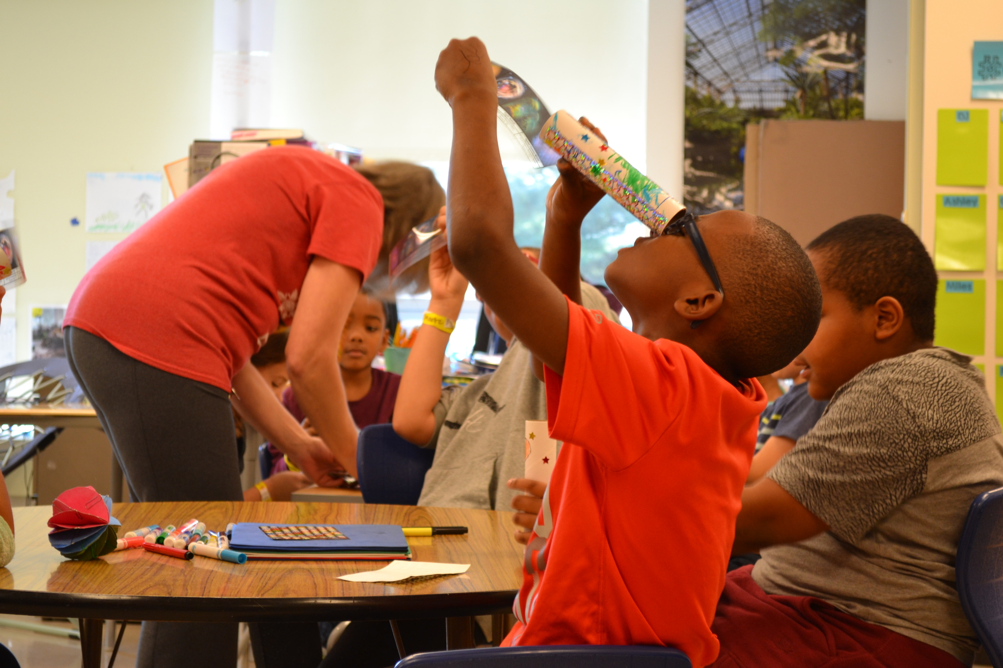
Beyond PBL: Teaching and Learning in STEM/STEAM Schools
Heather Sherman
Battelle
STEM Designation Overview

Slide 2
Learning Objectives
Review the relationship between culture, curriculum and connections to the community to facilitate high-quality STEM/STEAM education
Identify practical strategies to:
Incorporate authentic, problem-based learning and design thinking
Provide learning experiences provide students with opportunities to see intentional connections between content areas
Create and use dynamic assessments to measure student learning
Support personalized learning
Discuss the role of the curriculum team and

Slide 3
Format for today
Review STEM Quality Model (highlights)
Panel discussion
Please participate in the discussion
Contribute to the collaborative note-catcher
Panelists:
Christina Ramsey, McKinley STEMM School, Principal
Tamee Tucker, iSTEM Early College High School, Chief Academic Officer
Jenn Reid, Dayton Regional STEM School, Training Center Coordinator & PBL Coach

Slide 4
Review!

Slide 5
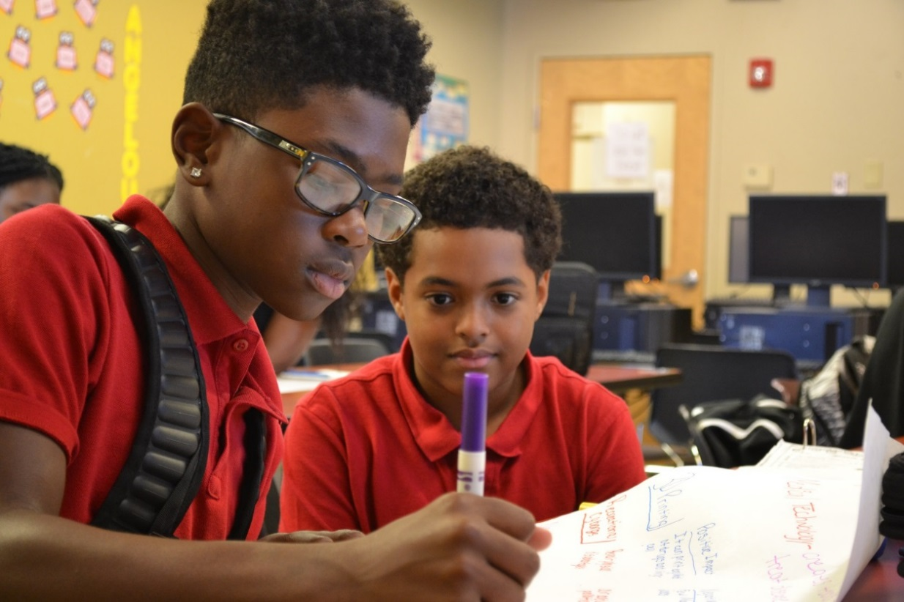
STEM/STEAM Schools
Culture of innovation
Inquiry-based, hands-on instruction throughout all content
STEM/STEAM partnerships
Leader and teacher development
Strong connection to institutes of higher education, particularly at secondary level
Curriculum team – with community experts including industry partners and experts in arts integration for STEAM
5

Slide 6
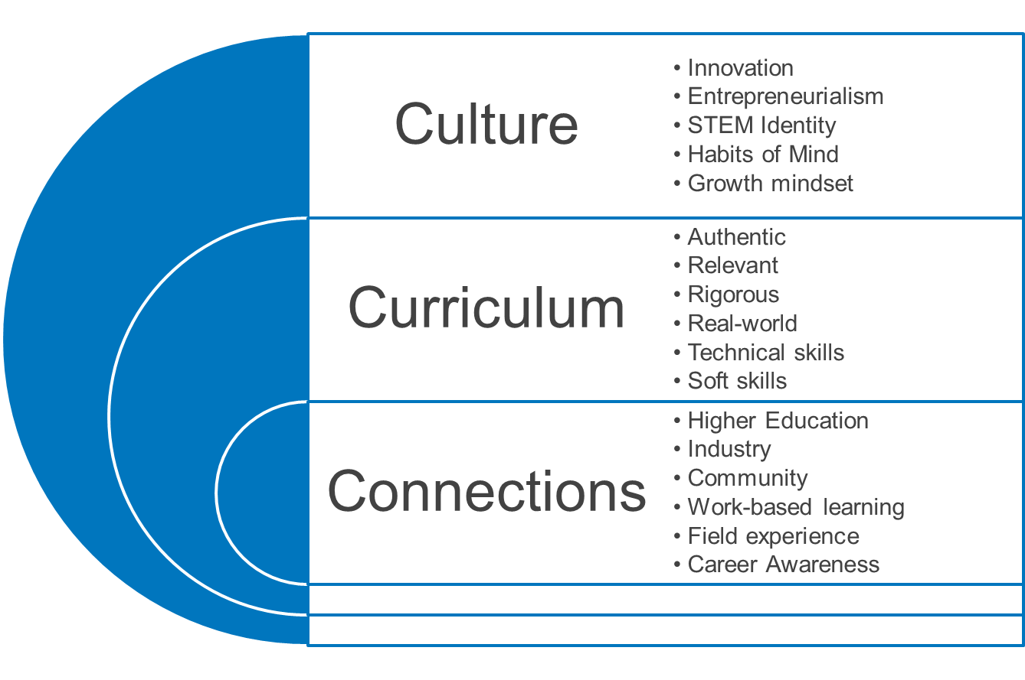
STEM/STEAM is for ALL students

Slide 7
Designation Resources
ORC 3326.03
Quality Model for STE(A)M Schools
Ohio Revised Code outlines requirements for STEM/STEAM schools
New – schools must re-apply every 5 years
Outlines the characteristics and attributes of a high-quality STEM or STEAM school
Roadmap to designation
Designation Application
Application Rubric
Aligned to ORC 3326.03 and Quality Model
Schools must provide evidence that they meet the criteria stated in the law
Aligned to ORC 3326.03, Quality Model and Application
Initial, Approaching, Accomplishing, Model

Slide 8
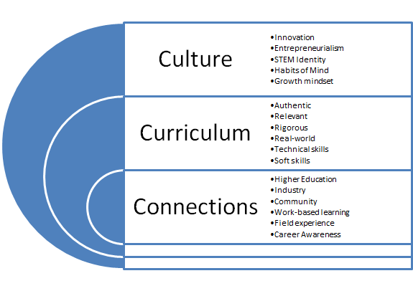
What is the quality model?
Details essential criteria for high quality STEM and STEAM implementation
Defines the three domains of STEM and STEAM
Domain 1: A Culture of Learning (Culture)
Domain 2: Learning and Teaching (Curriculum)
Domain 3: Pathways to Success in Careers (Connections)

Slide 9
Quality Model Learning Domains

Slide 10
Domain I: A Culture of Learning
Innovation, entrepreneurial spirit
Inquiry
Collaboration
Accountability
Inclusivity
Habits of mind/values
Personalized
Student-driven
Leadership EXPECTS and ACCEPTS innovation

Slide 11
Domain II. Learning and Teaching
Inquiry-based Learning
Problem Based Learning
Interdisciplinary
Growth mindset
Student ownership
Authentic assessments
Mastery/competency
Investment in teachers

Slide 12
Domain III: Pathways to Success in Careers
Connections: creating connections to the community creates context for classroom learning!
Helps answer the question, “when are we ever going to use this in the real world!”
Career exploration must be demonstrated by every school – even early elementary

Slide 13
Essential Criterion 1: STEM and STEAM schools exhibit cultural strategies that reflect innovation, an entrepreneurial spirit, inquiry, and collaboration with individual accountability.
Essential Criterion 2: STEM and STEAM schools exhibit an inclusive mission that supports ALL students.
Essential Criterion 3: STEM and STEAM schools exhibit opportunities for personalized learning.
Essential Criterion 4: STEM and STEAM schools exhibit flexible and autonomous leadership that communicates a shared vision, and that supports innovative instruction.

Slide 14
Essential Criterion 5: STEM and STEAM schools exhibit learning that prepares ALL students for college and careers in STEM, and that preserves disciplinary and interdisciplinary integrity.
Essential Criterion 6: STEM and STEAM schools exhibit authentic, problem-based learning and design thinking.
Essential Criterion 7: STEM and STEAM schools exhibit an integrated, innovative curriculum.
Essential Criterion 8: STEM and STEAM schools exhibit dynamic assessment systems that include authentic, performance-based assessments.
Essential Criterion 9: STEM and STEAM schools exhibit a well-prepared teaching staff, with ongoing and personalized professional learning.

Slide 15
Essential Criterion 10: STEM and STEAM schools exhibit curricular connections with business and industry, providing opportunities and access for success in college and career.
Essential Criterion 11: STEM and STEAM schools exhibit STEM-rich formal and informal experiences with the community that are personally relevant to the student.
Essential Criterion 12: STEM and STEAM schools exhibit collaborative partnerships with business, industry, arts, and higher education that provide and enhance opportunities for practical and real-world experience.

Slide 16
Panel Discussion
Note-catcher link

Slide 17
Design Thinking: Orientation to STEM LIFE skills
Collaboration
Critical thinking
Communication
Creativity
Cultural Competency
Character Development

Slide 18
Designation Application Questions

Slide 19
1. Evidence of school culture (application questions)
1.1 How does the school culture promote innovation, entrepreneurialism, inquiry and collaboration?
1.2 Describe how the school culture demonstrates an inclusive mission and commitment to personalized learning.
1.3a Describe how the school’s leadership team exhibits flexible and autonomous leadership, communicates a shared vision and supports innovative instruction.
1.3b Provide evidence of school structures in place to support routine STEM-focused professional development throughout the entire school. (i.e., common planning time, professional development funds).
1.4a Describe how the school’s governing body (and/or STEM/STEAM advisory group) is selected and its level of support for the operation of a STEM/STEAM school.
1.4b Please provide a link to the listing of the school’s board members or list below.
1.4c STEM/STEAM Advisory Group Members (if applicable)
1.4d Describe how members of the advisory group were selected and how they have contributed to the growth of STEM/STEAM in the building.

Slide 20
1. Curriculum Team (application questions)
1.4e Describe how the school’s curriculum will be developed by a curriculum team* consisting of, at minimum:
1) the chief academic officer;
2) a higher education partner;
3) a teacher; and
4) a member of the public with expertise in the application of science, technology, engineering or mathematics. Describe how the team will develop an innovative curriculum.
*If the proposal is for a STEAM school or STEAM school equivalent, the curriculum team also must include an expert in the integration of arts and design into the STEM fields. Sometimes, the STEM/STEAM advisory team and curriculum team can be the same.

Slide 21
2. Learning and Teaching (application questions)
2.1 Show how personalized learning, reasoning and problem solving (scientific reasoning, engineering design, computational thinking, design thinking, argument from evidence) are emphasized throughout the curriculum. Please include your design cycle/process image (if available) the school/district utilizes and integrates into learning experiences
2.2a Describe how problem-based learning drives instruction and curriculum.
2.2b Provide examples of Problem-based Learning.
2.2c Describe how the school implements a curriculum with interdisciplinary connections and frequently uses technology to enhance student learning. Be sure to include how the arts and humanities are integrated in the STEM/STEAM disciplines.
2.3 Describe how student learning is assessed.
2.4a Describe how the school recruits and retains faculty members with a high interest in STEM/STEAM education and experience with innovative instructional methods.
2.4b Describe how teachers effectively and consistently use best practices in STEM/STEAM pedagogy.
2.4c Highlight any professional development sessions on STEM/STEAM best practices that school staff have attended.

Slide 22
3. Career Exploration
3.1 What access does the school provide to students to support career exploration/interests? If applicable, provide details about student participation in College Credit Plus and other certification programs.
3.2a Detail the established community partners and their roles within the school. *STEAM applicants must provide an art/humanities partner.
3.2b Describe how partners are involved with curriculum development, provide practical, work-based learning experiences and student support and/or share resources with the school.
3.3 Describe how the school provides students with STEM/STEAM-rich formal and informal relevant experiences with the community.

Slide 23
Process and Timeline

Slide 24
Application Process
Complete “intent to apply” (by December 15th!)
Submit draft for feedback to OSLN (optional) January 19, 2022
Officially submit to ODE – Feb 24, 2022 by 5 pm.
OSLN site visits to selected schools (March/April 2022)
OSLN will review and notify you of our recommendation (Spring 2022)
OSLN makes recommendations to STEM Committee (Spring 2022)
Designations granted in the Spring (by the STEM Committee)

Slide 25
Designation Timeline
November 15: FY23 Application posted
December 15: Complete this survey to inform the Ohio Department of Education and the Ohio STEM Learning Network on your intent to apply and if technical assistance will be pursued.
January 19: Submit a rough draft of the application/portfolio to the Ohio STEM Learning Network for technical assistance. Email rough drafts to osln@battelle.org. You will receive feedback on your draft application in time to make changes prior to the final submission to Ohio Department of Education.
February 24: Final applications due to the Ohio Department of Education by 5 p.m.
March-April 2022: After a preliminary review from the Ohio STEM Learning Network, site visits to selected schools will be conducted during the spring (March/April). A school may also request a site visit when submitting their application.
April 2022: Applicants will be notified of the Ohio STEM Learning Network’s recommendation.
May 2022: The Ohio STEM committee will vote on designated schools.

