Slide 1
Career Connections
March 2015
Notes:
We have 1 million Ohioans without a high school diploma or GED. That number grows by 24,000 annually as current high school students continue to disconnect and disengage from school. In 2010, Ohio had a dropout rate of 4.2 percent. Which is above the national average of 3.4 percent (U.S. census data).
WHY:
Create relevance and purpose in the classroom
Identify career interests for making informed decisions, based on research and experiences; structured and supported environment for planning
Promote post-secondary options, access, and completion
Maintain engagement, focus, and motivation
Research shows that a consistent factor in the reason for students dropping out early in high school is a lack of motivation due to the perceived irrelevance of school.
Thus, students aren’t seeing the connection to what they are doing in the classroom and the purpose and relevance is has with the real world or world of work.
Career Connections is Ohio’s vehicle for increase students’ awareness of the connections between the classroom and their career pathways.
In order to do this we have to help them realize their career interests. Using tools to develop and increase their career maturity which will lead to more informed decision making.
We have to be sure that students are making decisions based on data and information. This means that they need experiences throughout high school so that they can determine not a specific career but a pathway. Students who enroll in college as undecided often times continue as undecided. They may not receive or seek out the support they need to make a decision about a major. Ultimately this increases the likelihood of them dropping out or accumulating unnecessary debt.

Slide 2
Research shows that a consistent factor in the reason for students dropping out of high school is a lack of motivation due to the perceived irrelevance of school.
Notes:
We have 1 million Ohioans without a high school diploma or GED. That number grows by 24,000 annually as current high school students continue to disconnect and disengage from school. In 2010, Ohio had a dropout rate of 4.2 percent. Which is above the national average of 3.4 percent (U.S. census data).
WHY:
Create relevance and purpose in the classroom
Identify career interests for making informed decisions, based on research and experiences; structured and supported environment for planning
Promote post-secondary options, access, and completion
Maintain engagement, focus, and motivation
Research shows that a consistent factor in the reason for students dropping out early in high school is a lack of motivation due to the perceived irrelevance of school.
Thus, students aren’t seeing the connection to what they are doing in the classroom and the purpose and relevance is has with the real world or world of work.
Career Connections is Ohio’s vehicle for increase students’ awareness of the connections between the classroom and their career pathways.
In order to do this we have to help them realize their career interests. Using tools to develop and increase their career maturity which will lead to more informed decision making.
We have to be sure that students are making decisions based on data and information. This means that they need experiences throughout high school so that they can determine not a specific career but a pathway. Students who enroll in college as undecided often times continue as undecided. They may not receive or seek out the support they need to make a decision about a major. Ultimately this increases the likelihood of them dropping out or accumulating unnecessary debt.

Slide 3
State Initiatives
Career Exploration Internship and Community Connectors: Funding to expand mentorship and internship programs for students
OhioMeansJobs K-12 Resources: Provide career decision-making materials and OhioMeansJobs K-12 information through school newsletters to parents
Career Advising Policy and Student Success Plans: Requirement for all districts, specifically targeting students who are at-risk of dropping out of school
Notes:
Growing emphasis on career advising from both state and national levels – business and industry are struggling to fill positions because students aren’t attracted to these high-demand areas.
Funding Opportunities:
Community Connectors-- http://communityconnectors.ohio.gov/
Career Exploration Internship -- http://codes.ohio.gov/orc/122.177 -- http://development.ohio.gov/bs/bs_oceip.htm
New Laws:
April 1, 2015; Provide info about OhioMeansJobs K-12 in school newsletter and website: http://codes.ohio.gov/orc/6301.15
September 2015; Adopt a policy on career advising: http://codes.ohio.gov/orc/3313.6020

Slide 4
Career Connections
Aligns district efforts to ensure consistent and ongoing opportunities for all students
Embeds curriculum strategies that help students link their learning to future careers
Engages students in opportunities to discover their career interests, explore pathways and make plans for their future
Notes:
Career Connections is about creating authentic learning situations for students of grades K-12 where they have opportunities to develop the skills and knowledge needed to prepare for global competition, rigorous post-secondary education and training, and high-skill high-wage careers.
Organized to foster connections between what students are learning in the classrooms and the expectations and demands of the workplace – think: critical thinking, problem solving, collaboration, leadership, innovation, creativity, etc.

Slide 5
Background
Career Connections is a joint initiative among the Governor’s Office of Workforce Transformation, Ohio Board of Regents, and Ohio Department of Education
Governor’s Office of Workforce Transformation
2014 Strategic Plan workforce.ohio.gov
Notes:
Career Connections:
Initiated by Governor Kasich; established the Office of Workforce Transformation which focuses on making Ohio’s workforce efforts more efficient and effective.
Priorities set in the 2014 State of the State by Governor Kasich: create more opportunities for students to connect to careers
Partnered with Gov’s Office of Workforce Transformation to focus on developing our future workforce

Slide 6
Resources
Career Connections K-12 Framework
Career Connections Learning Strategies
OhioMeansJobs K-12
Notes:
The first component created for Career Connections were the curriculum strategies (SB 316). However, the framework drives the big picture – looking at all efforts across K-12 and aligning them to build a continuous experience for students. Notice I said K-12, this isn’t a high school thing this involves all educators – including teachers, counselors and administrators. Building a continuum for students so that each year there are purposeful experiences planned that support students with recognizing the linkages from the classroom to the workplace.
The third component is OhioMeansJobs K-12; this new tool launched fall 2014 and is available to all Ohioans at no cost. The portal is intended for students in grades 6-12.
I’m going to discuss these components in a little more detail, and please feel free to ask questions as we progress.

Slide 7
Framework
Career Awareness
Kindergarten through Grade 5
Career Exploration
Grades 6 through 8
Career Planning
Grades 9 through 12 and beyond
Notes:
The Career Connections Framework provides an overview for districts when developing local plans. The Framework is organized by career development phases that align with developmentally appropriate grade levels. One thing to recognize is that as students progress through school the items referenced continue – for example, career awareness is lifelong. We continue to learn about career options and explore new careers.
Awareness: exposure to more than what they are familiar with through their every day lives; provide examples where teachers can explain why school is relevant to their future and how it connects to the world of work – students should be able answer “why do we go to school” by 3rd grade; “what am I good at” in 4-5th
Exploration: opportunities to see and hear first-hand where their interests connect to the work place (involve community business partners – answer “what businesses and jobs exist in our community” “why type of jobs exist in our community”)
Planning: meaningful, deeper experiences (internships, shadowing, pre-apprenticeships, research employers, interview professionals) research the options and what it takes to get there “how do I prepare for the career I’m interested in” “what connections can I make to better prepare me for that field”
Developmentally appropriate; this isn’t apprenticeships in elementary grades. Some of this work will already be in place in your schools. Other schools will need some help getting started. All schools will be approaching this from a different level and perspective priorities and resources vary, so this isn’t punitive. Ultimately, students need to be exposed to career pathway options earlier and more consistently. Families need to have access to tools and resources to support students with making informed decisions and start conversations sooner.

Slide 8
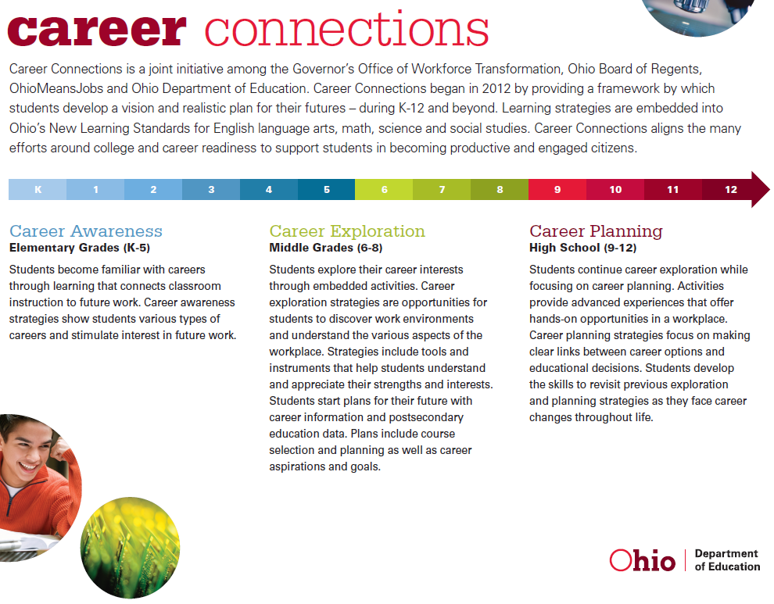
Notes:
Looking at your handout – or the electronic document online at education.ohio.gov – career connections – you’ll see the summaries on page one explaining the three levels. Recognizing that they building upon one another and create an ongoing continuum that doesn’t end in high school, but rather prepares students to implement and apply throughout their careers.

Slide 9
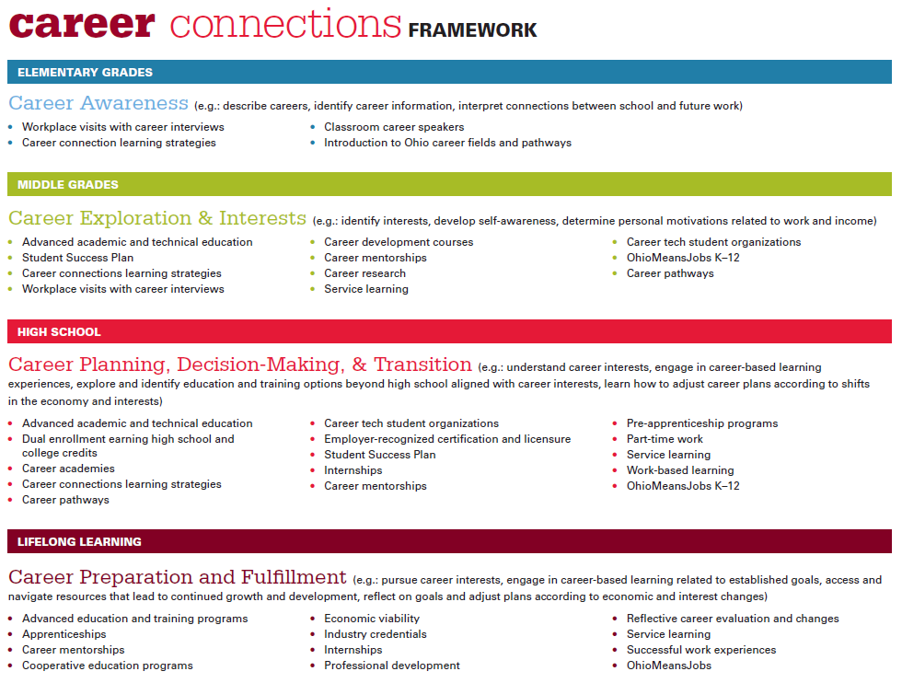
Notes:
Page two includes strategies at each level that include academic curriculum, experiential learning, and career education. Students need opportunities within a structured and supported environment to explore their options and try things out to find out more about what they like and don’t like.
College is expensive – any way you look at it. Regardless of a families ability to pay for education beyond high school, the cost is high. Career Connections is about providing kids opportunities to sample more things and get a better idea of the career fields that interest them. This is not about nailing down exact career choices - we know that isn’t realistic. But students should recognize before they leave high school that engineering is science-intense curriculum, becoming a veterinarian requires 8-10 years of schooling and that there are viable career options that require less than a four-year degree. This happens in classrooms across the state every day – this is about gelling all of the efforts to create a cohesive experience for students.

Slide 10
District Career Advising Policy
Career advising for grades 6-12
Student Success Plans for those identified as at-risk of dropping out of school beginning in grade 6
Supports and interventions necessary to successfully transition to their postsecondary destination
Notes:
Beginning in the 2015-2016 school year each local board of education for city, local, exempted village and joint vocational school districts will adopt a policy on career advising that addresses each of the eight components in state law: http://codes.ohio.gov/orc/3313.6020
Policies must be sent to CareerConnections@education.ohio.gov by Sept 30, 2015.
The overall themes fall into pathways, planning and learning.
Linking learning to careers
Advising all students beginning in grade 6
Identifying students at-risk of dropping out and developing student success plans accordingly
Training for staff on pathways and online tools
Multiple pathways to earn a high school diploma
Credit flex and other ways to earn both academic and career tech credit
Documentation of advising, available to student, parent, current and future schools the student may be enrolled
Supports and interventions needed for successful postsecondary transitions

Slide 11
Career Connections
Learning Strategies
Model Curriculum with embedded strategies aligned to Ohio’s New Learning Standards
Guide for Teachers with strategies to integrate in to local curriculum
Notes:
Everyday students attend classes during their school days where they don’t see the relevance or application of what they are learning outside of the classroom. Coordinating with teachers, counselors and administrators across the state in regional work groups – ODE compiled sample strategies that are embedded in the standards for English language arts, mathematics, science and social studies.
An example has been provided for you but you’ll find the strategies in their entirety on the ODE website – located on the content area webpage and the Career Connections webpage.
Video example from Edutopia:
http://youtu.be/7t30ZMX8uGw?list=PLGC_ueCYV2llcOeZMfqY_Vl3qBsS43Xl6

Slide 12
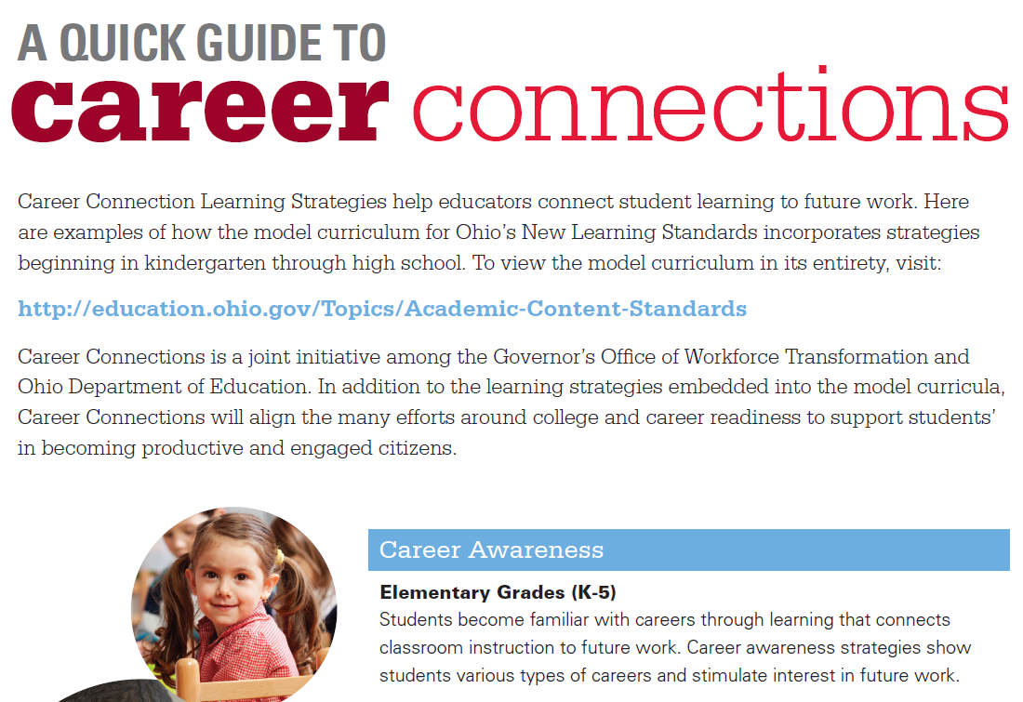
Notes:
Here is the cover page of the compiled document you’ll find on the Career Connections page – all strategies for grades K-12 and each of the four core content areas.

Slide 13
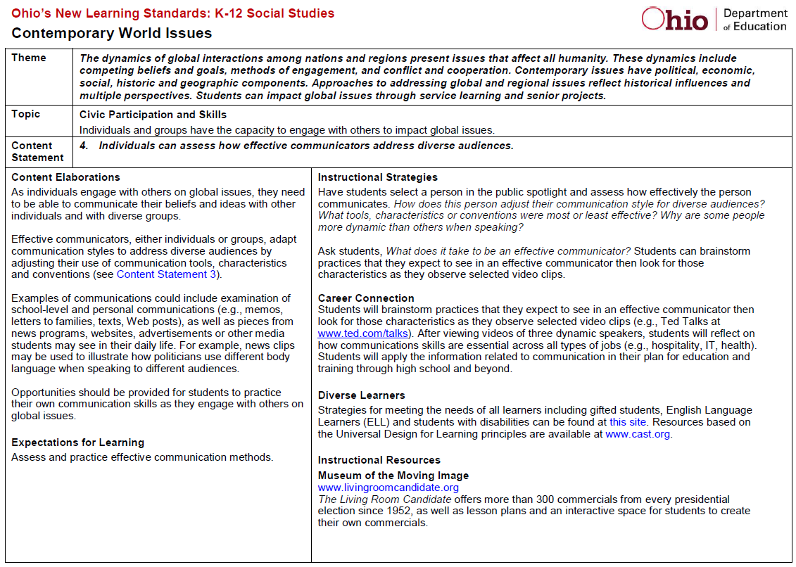
Notes:
Embedded into the model curricula for ELA, Math, Science, Social Studies;
The idea with the sample strategies is to show teachers how to extend what they are already doing in their classroom curriculum and make deliberate connections for students to the workplace. These connections are often obvious to educators, but unless we point them out to students it could be a missed opportunity to engage students and motivate their interests in the content.
The argument for the learning strategies is that it’s not asking teachers to do anything differently – it’s the same curriculum. But it’s being intentional about how students see the relevance of the content and learning expectations. When we consider the competing initiatives such as 3rd grade reading guarantee and evaluation systems – it has to be recognized that career connections is supporting the same outcomes. Preparing students to be successful through higher education and careers.

Slide 14
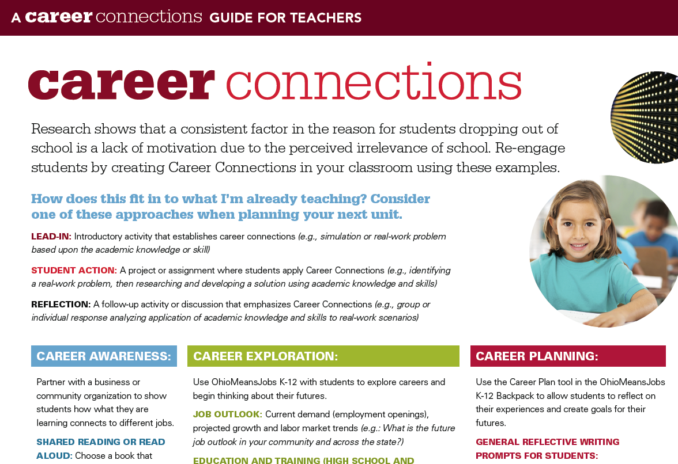
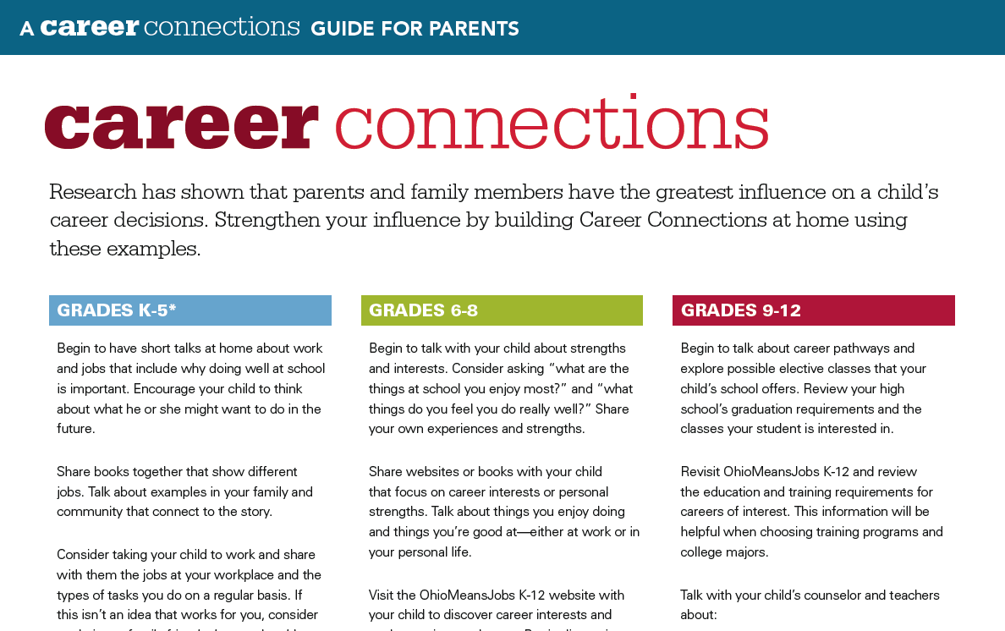
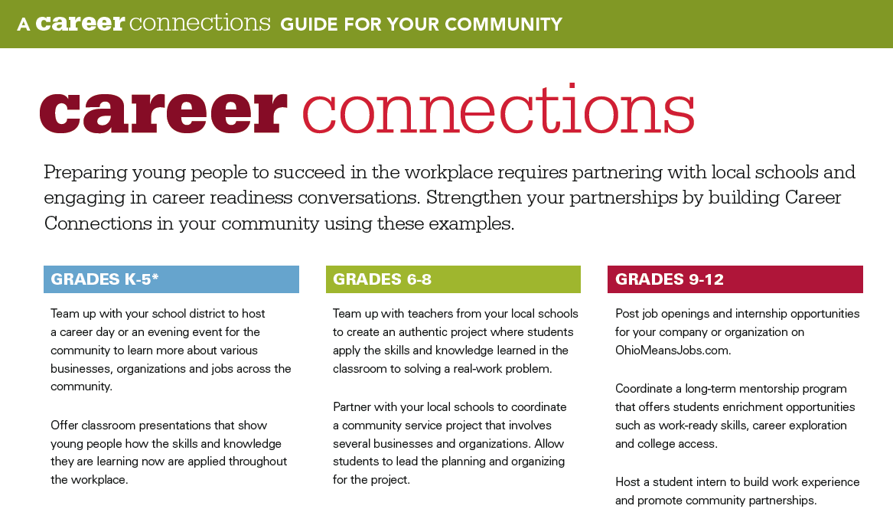
Notes:
Guides for teachers and counselors, parents and community members provide ideas for creating career connections across their respective reach. For example, if you lead advisory periods or coordinate events for students – the guide includes reflective questions to guide conversations and topics for presenters or students when interviewing professionals. Parents can discuss careers at home and help students think about their futures. Community and business members can partner with schools to offer students opportunities for learning more about the workplace and jobs in their region.

Slide 15
Career Pathways
Collective view on education and training, wage and outlook and related occupations within a career field or industry
Customized for each student and include multiple entrance and exit points
Notes:
Various Ohio policies mention the importance and role of pathways – college credit plus for postsecondary pathways; graduation requirements for pathways to earn a high school diploma and career advising for career pathways to explore options and begin planning for the future.
ODE, in partnership with OBR, OMJ and OWT, has developed sample pathways that can be adapted and customized to district, school or individual students.
These pathways represent a continuum of education and training and occupation – showing various “on and off ramps” that an individual can pursue based upon personal aspiration and commitment levels. While it’s important to be prepared, these examples recognize credentials that may be earned beginning in high school and reflect more of a “stackable” approach where education and training are ongoing, life-long ventures.
Video resource, Success in the New Economy: https://vimeo.com/67277269
This video provides a great overview for why career exploration and planning is necessary. Knowing about what options are available and evaluating those options against interest and skill support informed decisions. It’s a great backdrop for the career pathways and helping to reinforce the role that career information such as “in-demand” jobs has in planning. Take note of the 1:2:7 ratio…great transition to the next slide. Think Dentist (1): Hygienist (2): Assistant and other office staff (7).

Slide 16
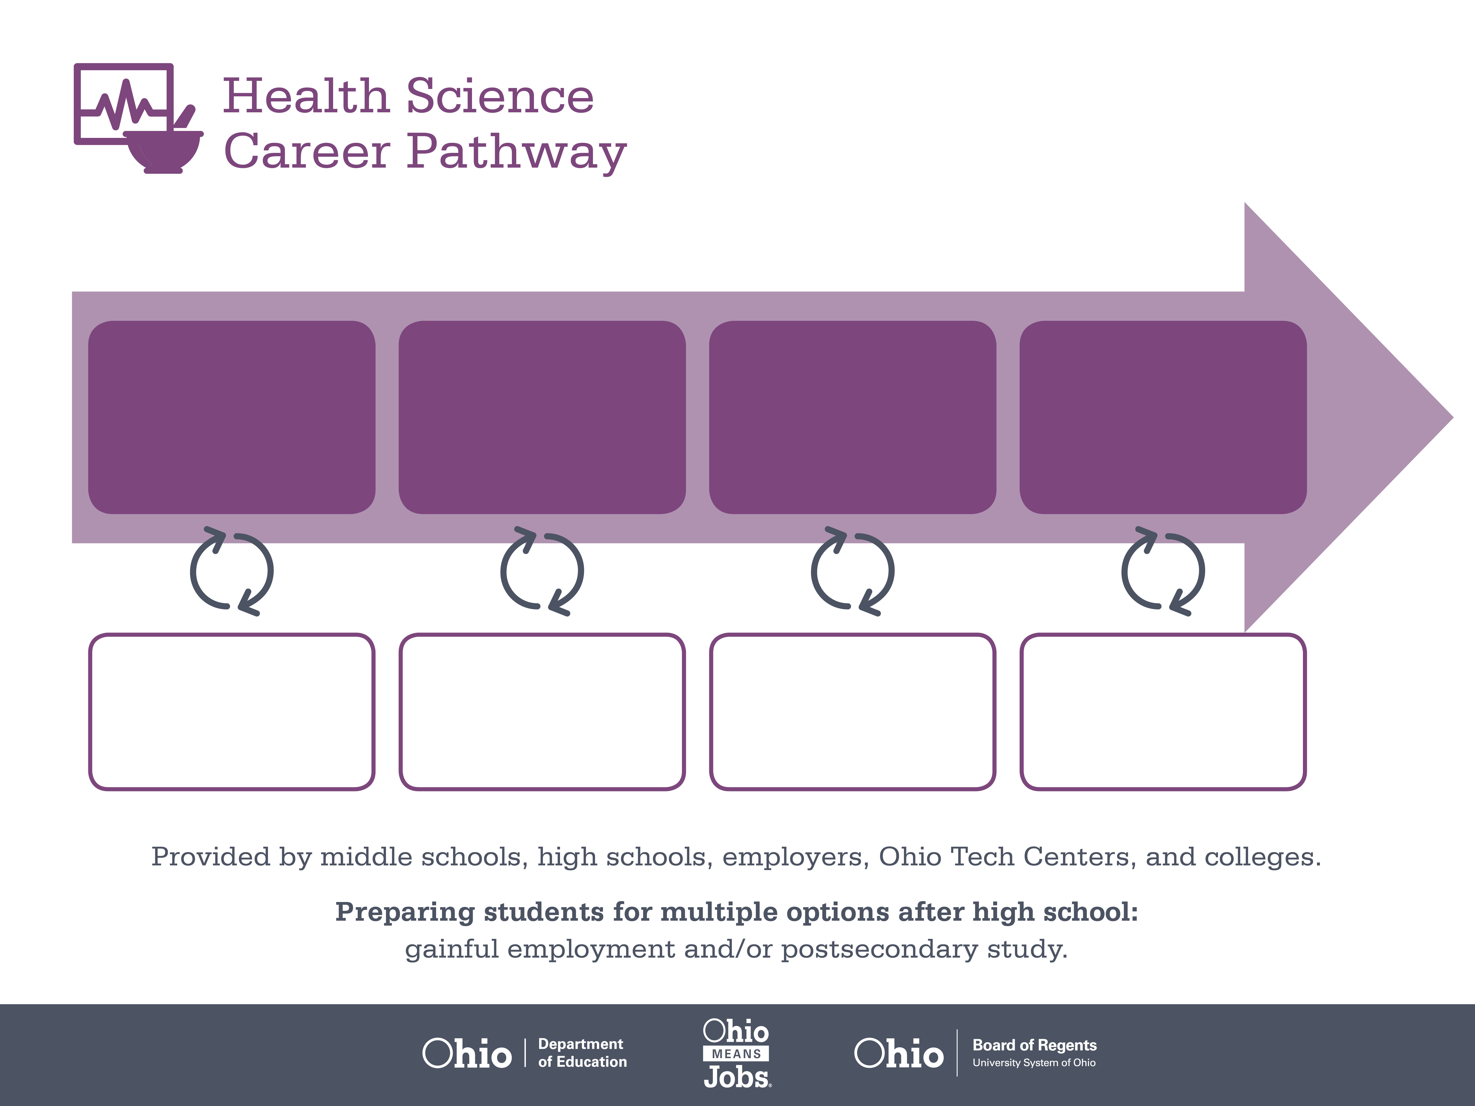
Certificate,
Dental Assisting
Associate or Bachelor’s
Degree, Dental Hygiene
Doctoral Degree,
Dentistry
Start Pre-Health
As early as grade 7
(based on readiness)
Dental Assistant
Median Salary: $33,690
Job Growth (10 yr): 20.5%
Annual Openings: 416
Average Tuition (1 yr): $0 –$3,900/yr
Dental Hygienist
Median Salary: $65,510
Job Growth (10 yr): 26.3%
Annual Openings: 345
Average Tuition (2 yrs): $3,900/yr
Average Tuition (4 yrs): $9,600/yr
Dentist
Median Salary: $158,460
Job Growth (10 yr): 9.5%
Annual Openings: 186
Average Tuition (4 yrs): $35,000/yr
Workplace Visits
Job Shadow
Internship
Work
Supervised Experience
---
Work
Supervised Experience
Internship
---
Work
Internship
---
Work
Ohio In-demand Occupations
Data reflects 2014 Ohio labor statistics and public institutions of higher education for 2013-2014. For specific tuition costs, visit ohiohighered.org.
Notes:
The dental pathway demonstrates how a student may begin, if ready, as early as grade 7. Grade 7 is when, in Ohio, students may begin exploring or “trying on” various career pathways through middle grades career tech courses. As apart of Ohio’s goal with expanding career tech and offering options earlier – there are now more options for students to participate in these courses in middle grades.
The first occupation in this sample is dental assistant – note that dental assisting is a one-year certificate program. It’s an industry recognized credential that’s also aligned to an in-demand job in Ohio (indicated with the “orange thumbs up”). These in-demand occupations have been identified as high growth, high wage and high annual openings across the state. The importance in identifying them and sharing the information with students and families is so we build awareness of where Ohio’s economy is in greatest need but also where there are opportunities for employment in Ohio.
Along the continuum you’ll see dental hygienist and dentists. The idea within these occupations is to demonstrate a potential pathway an individual may progress through within a particular field. While this isn’t always a linear process, it shows one possible route with related occupations with progressive education and training requirements.

Slide 17

Secondary Pathway: Allied Health and Nursing |  |  |  | Postsecondary Program: Dental Hygiene
An Example of Courses with Secondary and Postsecondary Credits
Secondary | 7 8 | English I | Algebra I | Physical Science | Social Studies | Fine Arts | Health Science & Technology
 | 9 10 | English II | Geometry | Biology | World History | Health (.5) PE (.5) | Principles of Allied Health | World Languages
 | 11 | English III | Algebra II | Chemistry | U.S. History | Dental Technology | Medical Terminology | World Languages
 | 12 | English IV | Trigonometry/ Calculus | Anatomy & Physiology | U.S. Government | Dental Radiography | Oral Diagnosis & Treatment Planning
Postsecondary | Year 1 1st Semester | College Seminar | Human Patho-physiology | Dental Anatomy & Physiology | Dental Hygiene Pre-Clinic | Intro to Dental Hygiene | Periodontology I | Preventive Concepts | Techniques I
 | Year 1 2nd Semester | English | Intro to Microbiology | Techniques II | Clinic I | Oral Pathology | Periodontology II | Community Health Concepts | Dental Radiography
 | Year 2 1st Semester | Interpersonal Communication | Community Health | Techniques III | Clinic II | Sociology | Pharmacology | Dental Materials | Pain Management
 | Year 2 2nd Semester | Oral Communication | College Algebra | Techniques IV | Clinic III | Psychology | Dental Hygiene Case & Concepts | Humanities Elective
 |  | High School Career-Technical Education Program Courses
 |  | High School Courses for Postsecondary Credit (Including Apprenticeship Hours) and the Corresponding Postsecondary Courses
 |  | Required Courses
 |  | Recommended Electives
Visit education.ohio.gov/CareerConnections for reference information.
Course titles and sequences will vary between schools.
11/2014
Notes:
The second page of the career pathway samples provides one scenario of courses involved in the related area of study. Highlighted in the table are opportunities for college credit, career tech and required versus elective courses. These models will vary upon local school offerings but helps students and families realize what the academic and technical demand might be along this pathway. Whether the student is scheduling high school courses or projecting what they might do after high school these examples provide context for what types of courses will be most important according to the types of skills and knowledge in the career field.
These samples begin as early as grade 7 and span up to two years of postsecondary. These are not exhaustive and represent just one example of related coursework.
Where do we make the connection – this data was compiled using OhioMeansJobs.com. OhioMeansJobs is the dynamic tool students and teachers can begin using to explore career interests, in-demand jobs, Ohio schools and programs and more.

Slide 18
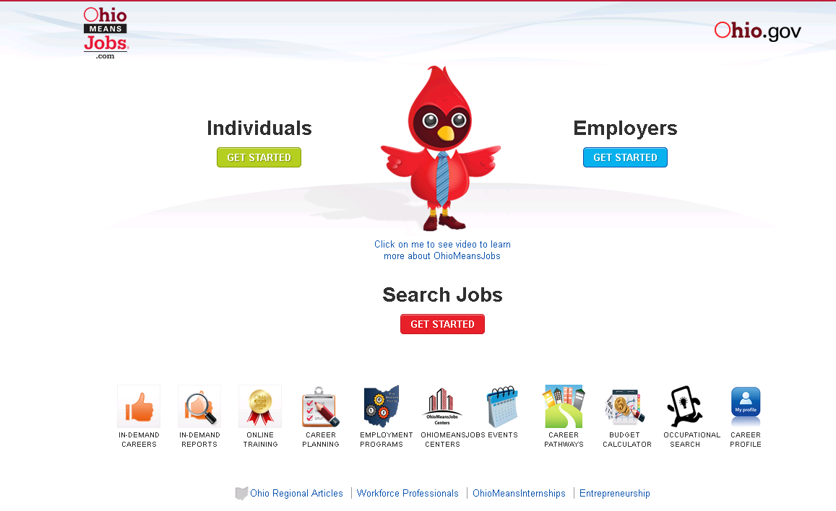
OhioMeansJobs.com Home Page
Notes:
This new no-cost resource was launched Fall 2014. It’s a resources available to all Ohioans and development is overseen by the Ohio Department of Education.
The concept for OMJ K-12 is to serve as an online career planning system that allows students to explore their career interests with inventories, research career options, and evaluate education and training programs.
All users begin at www.OhioMeansJobs.com; to access the K-12 portal click “Individuals” and the K-12 icon from the next page. You can also access the portal directly at: https://jobseeker.k-12.ohiomeansjobs.monster.com/seeker.aspx
NOTE: icons shown on this page are only for adult job seekers and are not connected to the OhioMeansJobs K-12 portal.

Slide 19

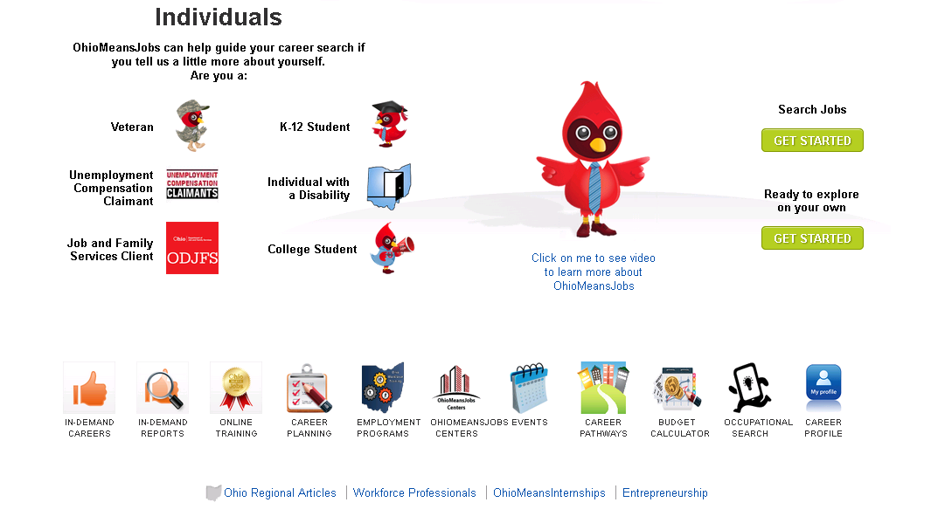
OhioMeansJobs.com: Choose K-12 Student
Notes:
All users will be directed to OhioMeansJobs.com and then instructed to choose K-12 (cardinal with the grad cap “OWEN”) to get started with OMJ K-12.
Note: OMJ is a hub for all members of the community – adult job seekers, veterans, employers, K-12 students and a new portal for higher education students (in development).

Slide 20
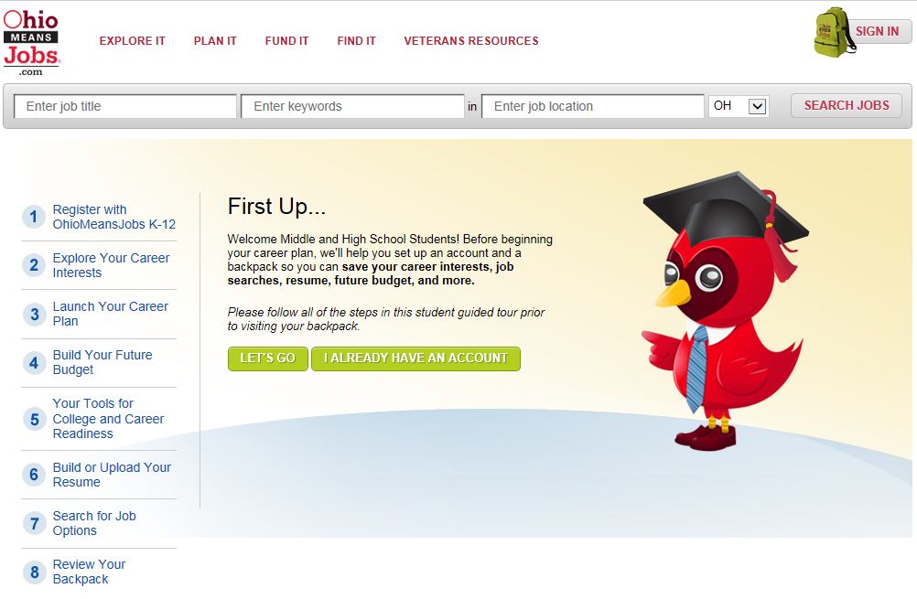
OhioMeansJobs K-12: Guided Tour “First Up”
Notes:
The online guide, “First Up” will guide students step by step through the registration, career exploration and planning process as well as help keep track of their progress. The first step is registration which has been customized to meet the needs of students, teachers and parents. While this feature follows a sequence, it also allows students to begin with the resources that meet their immediate needs. If a student would rather just to #4 and begin a budget, they don’t have to go through #1-3 prior to doing so.

Slide 21
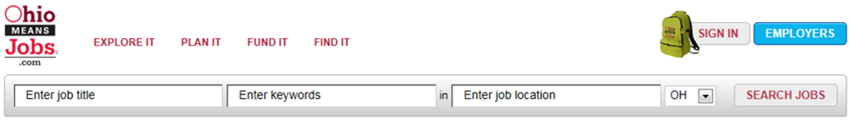
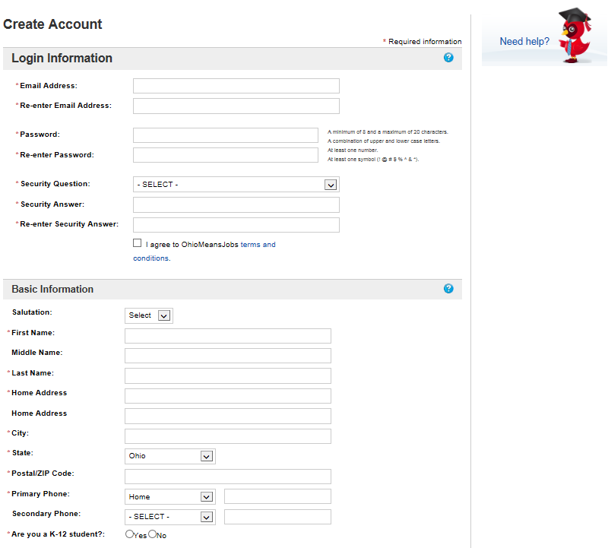
Registration – customized for students, teachers, and parents
Notes:
The online guide, “First Up” will steer students step by step through the registration, career exploration and planning process as well as help keep track of their progress. The first step is registration which has been customized to meet the needs of students, teachers and parents.
All accounts are synchronized among the OhioMeansJobs database and the Monster database which will allow users to move seamlessly through the many tools available – it will also prevent multiple accounts from being created for one user email account.

Slide 22
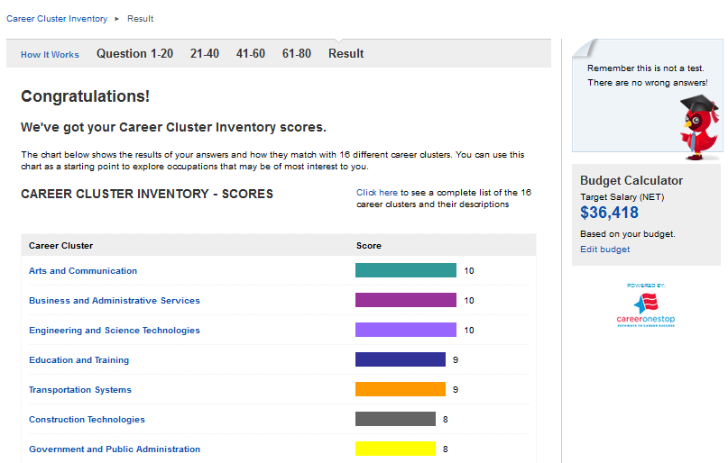
Career Cluster Inventory
Notes:
After registration, the second step is exploring career interests which will prompt students to complete a brief interest survey to identify which industries line up most closely with their interests. From there, students can explore which occupations are part of those industries. There will also be information available on which occupations are in-demand for each industry. In-demand occupations are selected by meeting a minimum requirement for annual growth rate, number of open positions and salary/wages.
Career Cluster Inventory – currently available in OCIS
Interest Profiler – O*NET tool, abbreviated version customized for OMJ

Slide 23
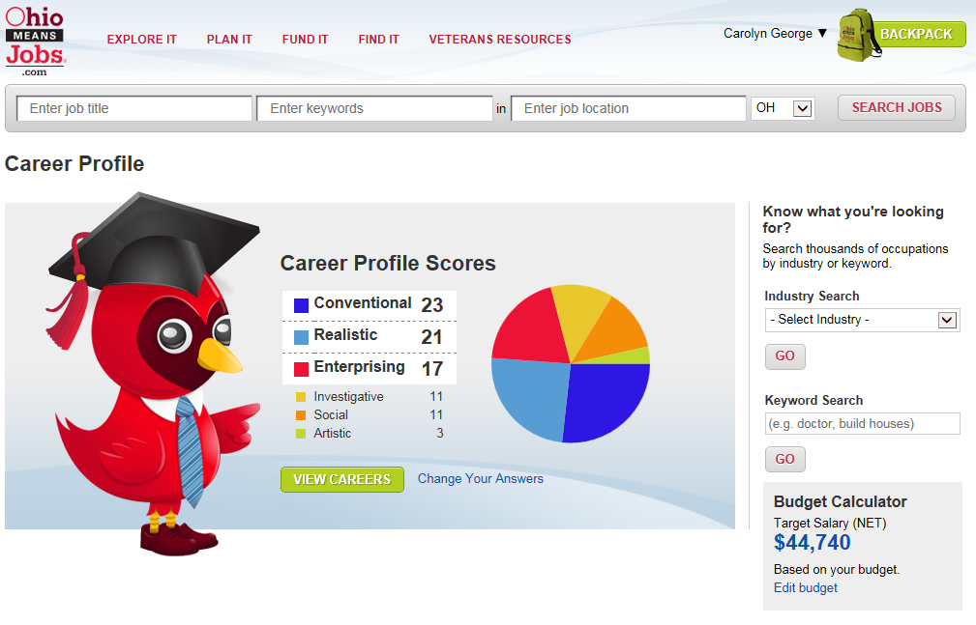
Career Profile
Notes:
After registration, the second step is exploring career interests which will prompt students to complete a brief interest survey to identify which industries line up most closely with their interests. From there, students can explore which occupations are part of those industries. There will also be information available on which occupations are in-demand for each industry. In-demand occupations are selected by meeting a minimum requirement for annual growth rate, number of open positions and salary/wages.
Career Cluster Inventory – currently available in OCIS
Interest Profiler – O*NET tool, abbreviated version customized for OMJ

Slide 24
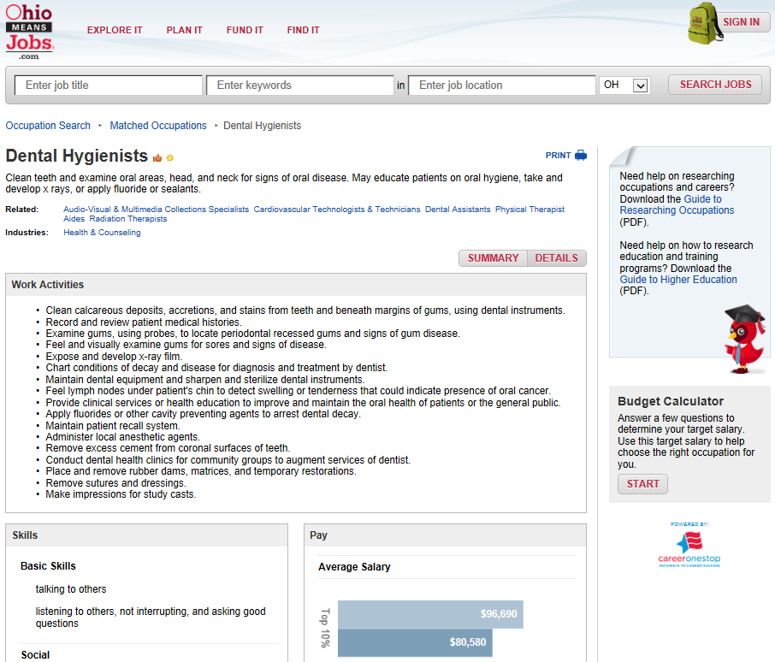
Career Information
Notes:
OMJ K-12 will offer seamless access to national and state labor market information – including career profiles, wages and trend data and education and training opportunities.

Slide 25
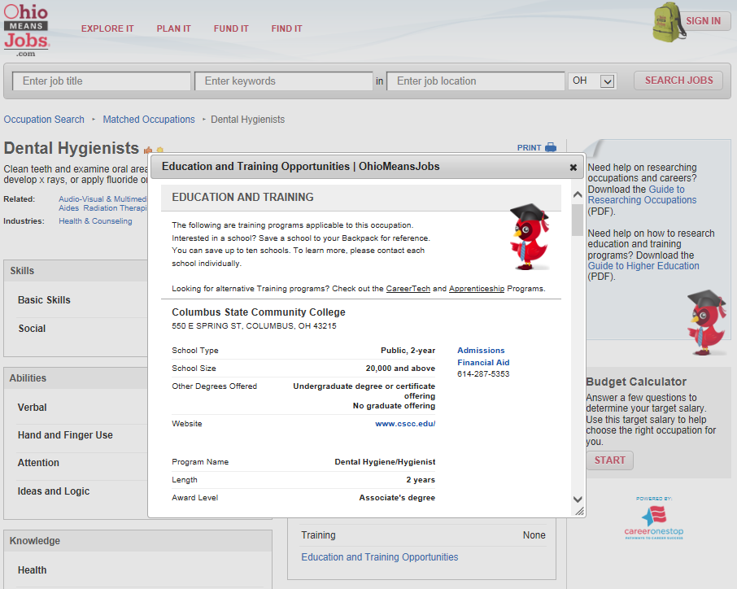
Education and Training Options
Notes:
Each occupation offers an embedded link for immediately viewing what programs and schools provide pathways that support getting a job in this field.

Slide 26
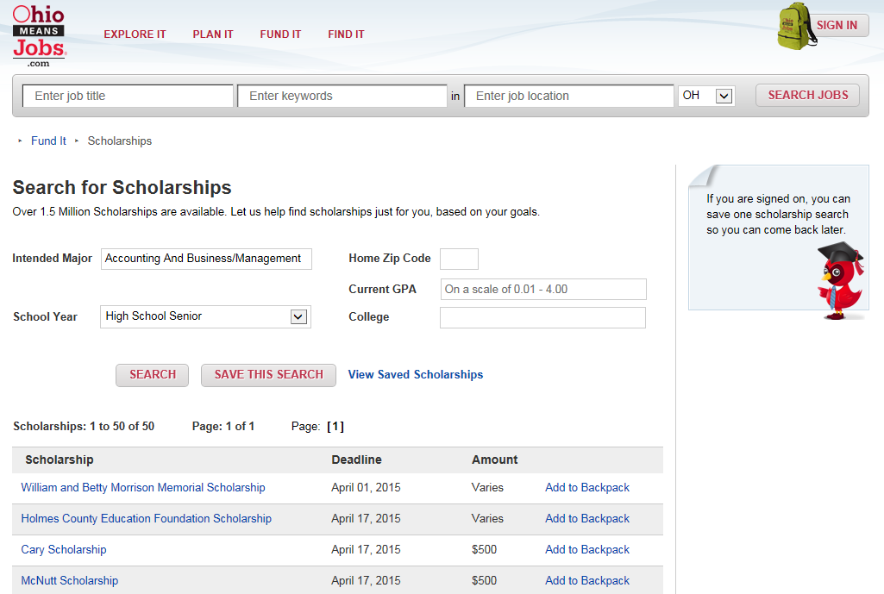
Scholarships
Notes:
Each occupation offers an embedded link for immediately viewing what programs and schools provide pathways that support getting a job in this field.

Slide 27
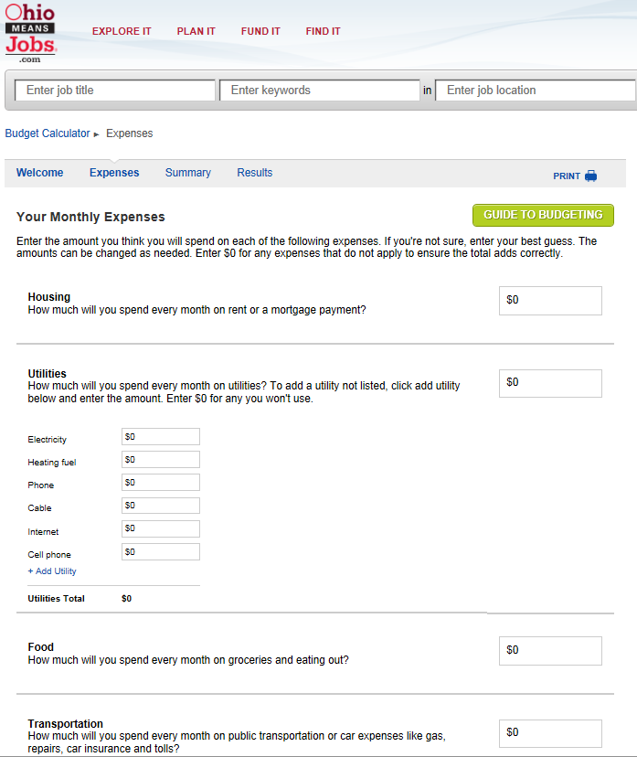
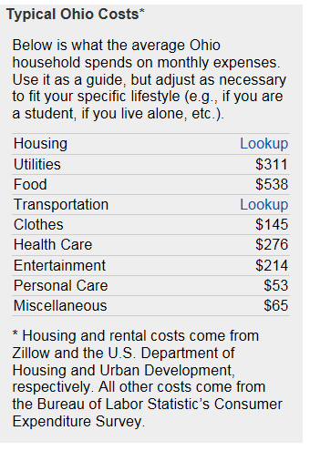
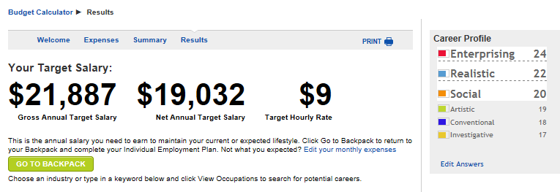
Budgeting For Your Future
Notes:
After career exploration, the third step is finding a target salary by using the budget calculator tool. This tool will prompt students to estimate living expenses and enter the information to identify the minimum salary required to cover their projected expenses. This information will also be helpful in deciding which occupation(s) students want to pursue as a career. The process of determining a target salary will also be helpful for students to give them an increased understanding of what types of expenses they can anticipate when they eventually live on their own.

Slide 28
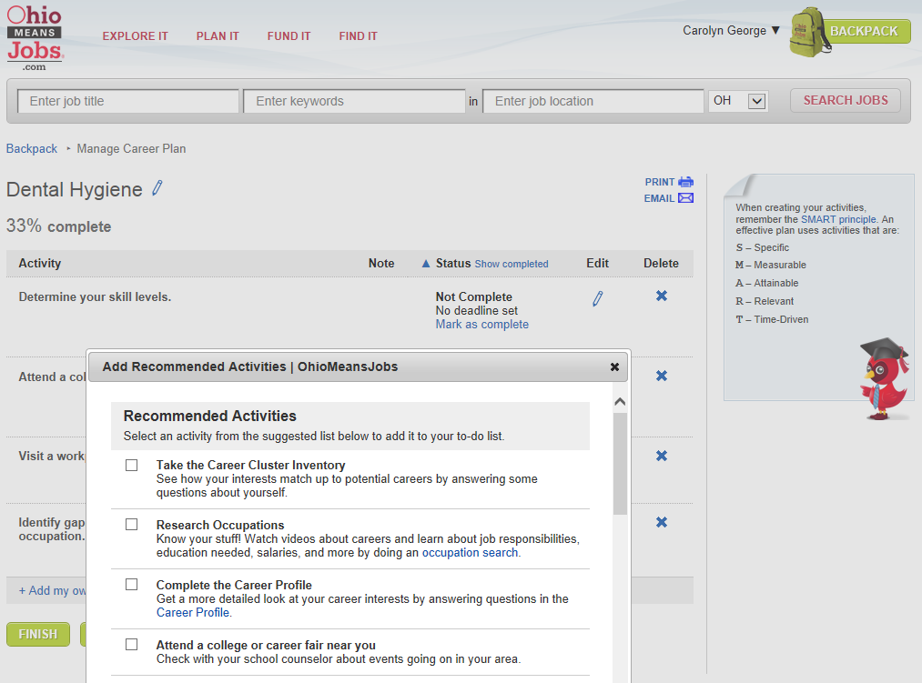
Career Plan
Notes:
After target salary, the fourth step is launching a career plan by using the career planning tool. This tool will prompt students with recommended activities to develop their career plan like researching what type of training/education will be needed to qualify for the different occupations. The tool will also recommend looking into different education/training programs and schools as well as possible scholarships, programs and financial aid for which students may be eligible to fund their training/education expenses. The calendar feature allows students to save tasks with deadlines and track their progress carrying out their career plans.

Slide 29
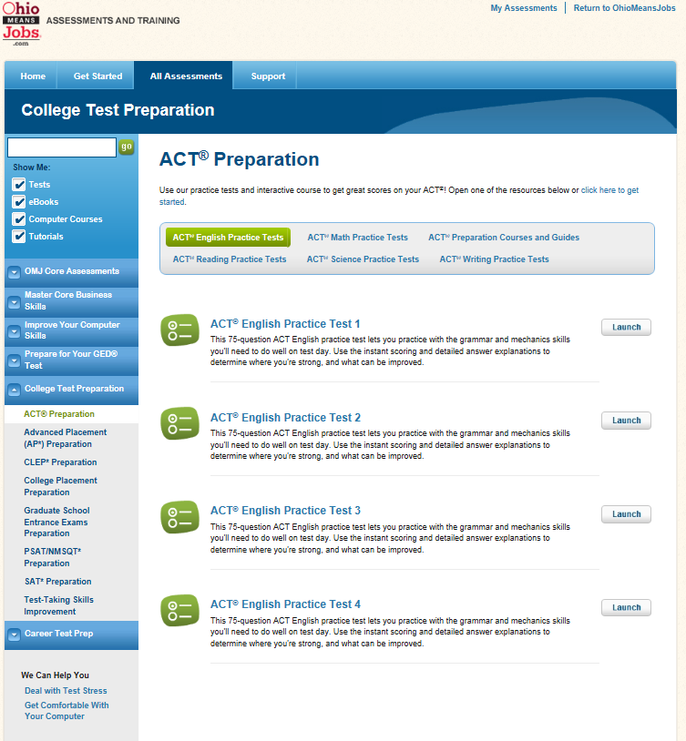
Tools for College and Career Readiness
Notes:
The online training center offers study guides and practice tests for college and career readiness. Students can prepare for college entrance exams like the ACT, PSAT and SAT or prepare for many career-based tests for their Commercial Driver’s License, Emergency Medical Technician certification or Real Estate License, etc.
The online training center offers a number of practice tests and tips for college entrance testing like the ACT and other tests as you’ll see on this sample page.

Slide 30
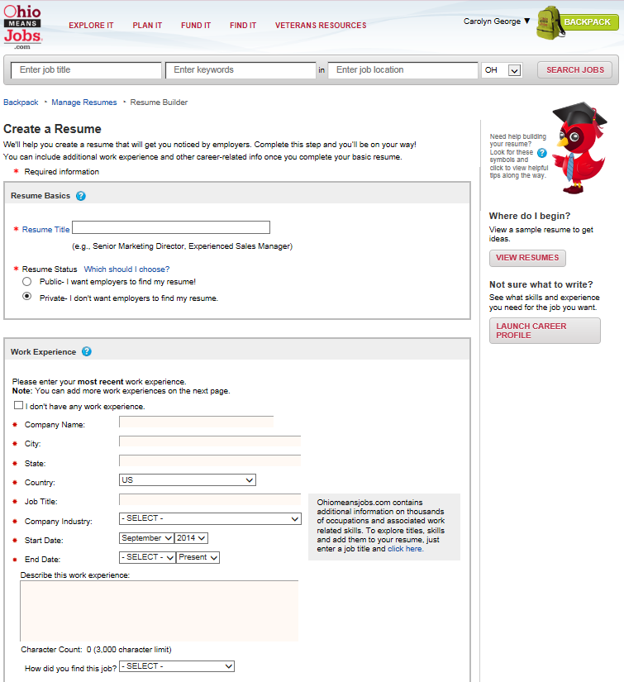
Upload or Build a Résumé
Notes:
After tools for college and career readiness, the sixth step is creating a resume by using the resume building tool. This custom tool will prompt students to either upload an already created resume or enter information like extracurricular activities, volunteer experience, work experience and Grade Point Average (GPA) to create a resume. There will also be a feature available to upload other important documents like transcripts, writing samples, references, etc. There will also be a tool to have the students resumes rated to learn how their resumes would likely compete with other job seekers. The resume rater also provides specific and practical tips on how each resume can be improved.

Slide 31
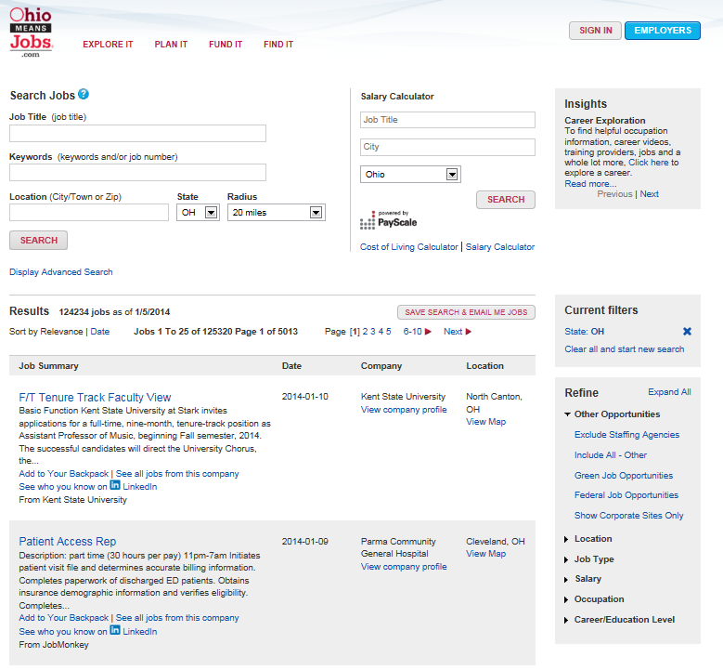
Job Search
Notes:
After resume builder, the seventh step is searching for job options. This tool will prompt students to enter key word or job titles and a job location to learn more about what types of job opportunities may be available in each occupation. Students can also perform searches to learn more about internships and co-ops available or even look for a seasonal or part-time position to apply for now. This tool can also help students identify which companies hire employees in the occupations they are considering, the number of openings available as well as the salary ranges for those positions.

Slide 32
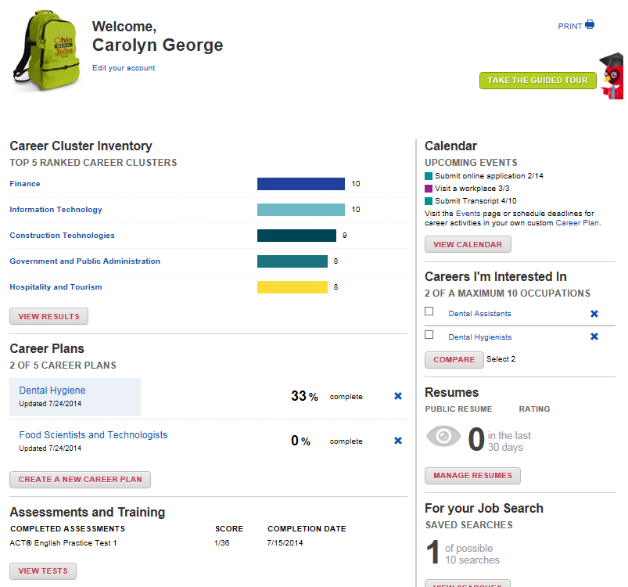
Backpack – Ongoing Individualized Planning
Notes:
Students will create a Backpack to save their information, but this also allows them to create a career plan, build a résumé and access a host of assessment prep tools such as ACT, SAT, ASVAB, COMPASS, ACCUPLACER, and much more.
Yes, this is available at no costs to all Ohioans – public, private, libraries, etc. everyone will have access. The system launched Fall 2014 and schools continue to be notified through ongoing ODE communications (Facebook, Twitter, Superintendent newsletter, etc.). Make sure you’re signed up to receive these communications (like the page, follow, and sign up for emails).
Thinking through these components and resources available – where do you get started? What’s one thing you can do when you get back to school? This year?

Slide 33
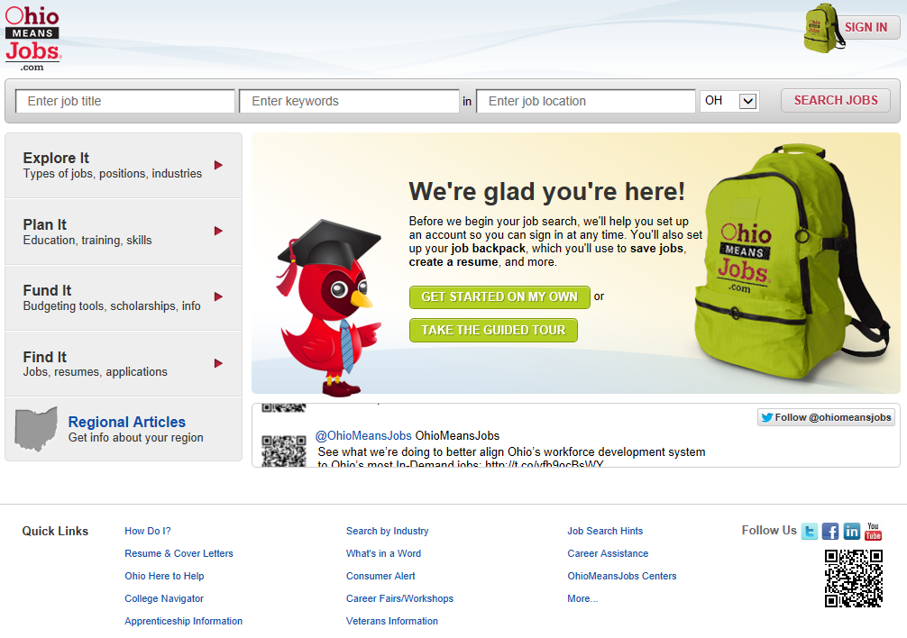
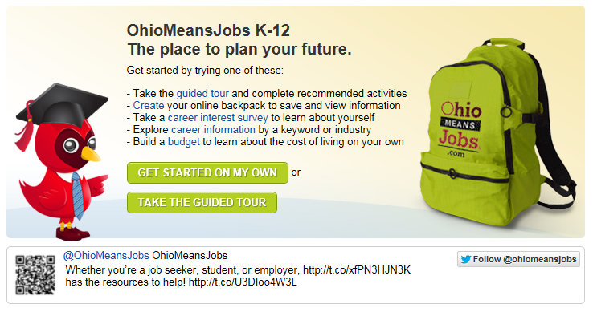
Self-Directed Exploration
Notes:
OhioMeansJobs is the premier résumé and job bank website in Ohio. Through a joint partnership between the Ohio Department of Education and the Ohio Department of Job and Family Services, this free and easy to use site has been expanded to include career exploration tools resources designed specifically for middle and high school students and their teachers. OhioMeansJobs K-12 will help teachers meet state requirements for career-related curricula and help students explore and plan careers.
Benefits for different stakeholders:
Educators: OhioMeanJobs K-12 will have tools and lesson plans to help educators engage students in career exploration.
Parents: OhioMeanJobs K-12 is designed to help you guide your children in the career exploration and planning process. This new site will also highlight which occupations are in-demand in each industry based on projected openings, growth rate, and salary. It can also help you plan your own career goals and search for your dream job.
Students: OhioMeanJobs K-12 is designed just for you. It can help you explore careers, create a budget to decide what type of salary you’ll need living on your own, decide what type of education/training you’ll need to achieve your career goals, identify ways to fund that education/training like scholarships, financial aid and other funding sources, create a resume and search for internships and jobs.
Businesses: OhioMeansJobs K-12 will help better prepare the future workforce and guide students towards in-demand occupations. Businesses can also benefit by advertising jobs, internships and co-ops at no cost as well as searching millions of résumés through OhioMeansJobs (a private public partnership with Monster.com) to find the best qualified job candidates.
Workforce and Human Service Professionals: OhioMeansJobs K-12 will be a valuable tool to help engage disadvantaged youth in career exploration and planning to help ensure that they become productive, self-sufficient adults. This site also has a budget calculator tool to give youth a better idea of what expenses they will need to cover once they are out living on their own to identify how much salary they will need to earn.
OhioMeansJobs K-12 also has a self-directed area available where students and teachers can:
Explore careers, occupations, regional information (articles, job fairs, workshops, etc.),
Look for funding opportunities like scholarships, financial aid and state and federal workforce programs
Research education and training programs for careers
Use the online training center to prepare for careers and/or college with study guides and practice tests
Create a resume
Search for internship and job opportunities
Estimate future expense to come up with a target salary to cover the cost of living expenses.
Develop a career plan with goals and target dates for completing tasks.

Slide 34
Next Steps:
Map what your school is already doing (who, what, when, where, how)
Identify champions at your school that will expand and enhance current efforts (administrators, colleagues, and community members)
Strategize what small steps your school will take initially, that will make a big impact overtime
Notes:
How do you get started – look at what you’re already doing. You’ll feel much more comfortable once you realize that you’re not starting from scratch. This will also give you an overview of the landscape – who’s already doing what and where.
Through this work you’ll identify some champions – the people that you won’t have to convince, because they already see the value. But you also have to bring together those with influence. Sometimes this is an administrator, parent – the ones with a loud voice and people hear when they speak. The other piece of your team needs to include your community members – business and industry, community organizations, higher education and career-tech. Those people that will realize a mutually beneficial partnership – developed workforce which leads to economic development.
Then you’ll strategize. Start small but with a big vision. Determine what impact you want to see and how you’re going to measure it. What data points will help to tell the story. How will you know you’re successful. Examples might include, 100% of 8th graders have begin a career plan; initiate an advisory program among freshman; provide quarterly career presentations for 4th graders. Start small but think big impact overtime.

Slide 35

education.ohio.gov/CareerConnections
Notes:
You’ll find information on the ODE website:

Slide 36





Social Media
Ohio Families and Education
Ohio Teachers’ Homeroom
ohio-department-of-education
storify.com/ohioEdDept
@OHEducation
OhioEdDept
Notes:
You can stay connected with ODE through these social media outlets:

Slide 37
Questions?
Carolyn George
Carolyn.George@education.ohio.gov | 614-995-5042
Tisha McGlaughlin
Tisha.McGlaughlin@education.ohio.gov | 614-466-5756
Career Connections
Office of Career-Technical Education
25 S. Front Street, Columbus, Ohio 43215 | 800-700-6247
Notes:
If you have questions, feel free to contact me:

